Slide 1
Data Science with Python
Summer 2016

Slide 2
Today
Hello
Data Science: what is it?
Course Overview
Python: check-in on codeacademy
Data Ingestion
Jupyter / ipython
Git / VirtualEnv
Check-in

Slide 3
What is Data Science?
What words come to mind when you think of Data Science?
What experience do you have with Data Science?
Why are you taking an Introduction to Data Science Class?

Slide 4
“Data”

Slide 9
^{Cities}
^{Infrastructure}
^{Industrial}
^{Family Assets}
^{Smart Appliances}
^{Personal Devices}

Slide 10
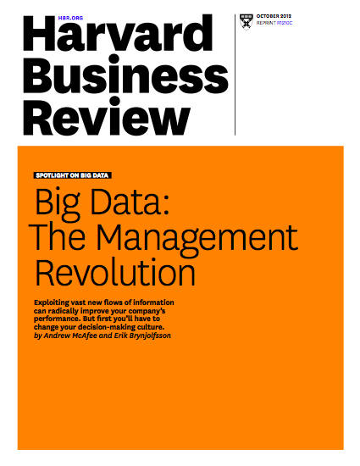

Slide 11
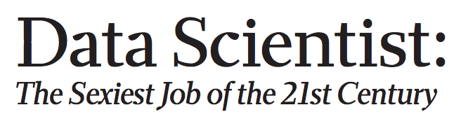

Slide 12
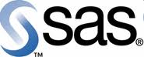
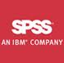

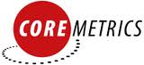







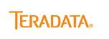






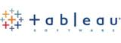





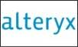




Slide 13
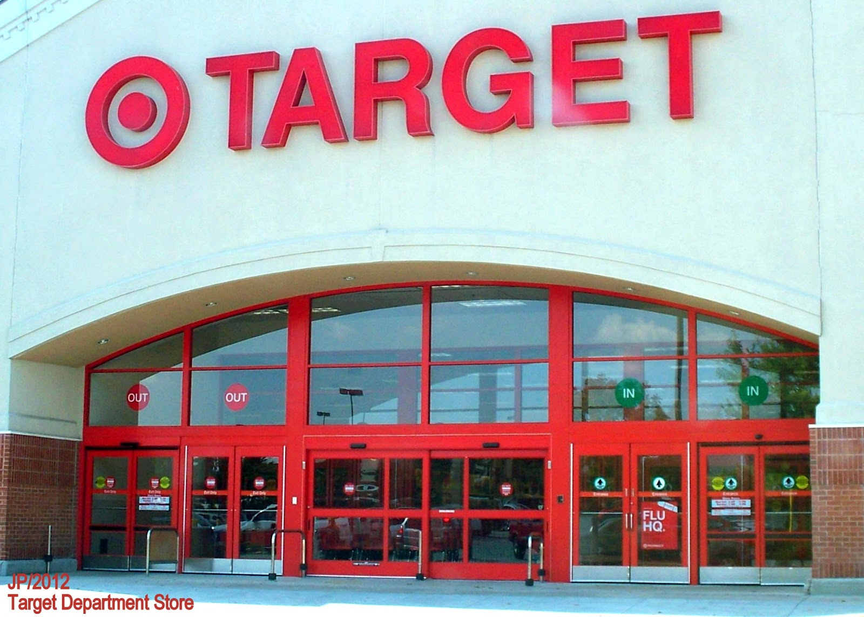
What is Data Science?
“How Companies Learn Your Secrets” NYT, by Charles Duhigg, February 16, 2012
http://bit.ly/targetdata

Slide 14
http://bit.ly/targetdata

Slide 15
What did Target Do?
Mining of data on shopping patterns
Specific products purchased
Combination of products purchased
Combined with demographic and other data
Psychology and neuroscience
Habits:
Cue-routine-reward
When are habits open to change?

Slide 16
Lessons from Target
Yes, Data Science is about mining data
There are deeper theoretical issues involved in understanding what you find
Left out of that long article are most of the critical steps that precede the analysis
In short, Data Science > data mining

Slide 17
Consumer data landscape
A framework for understanging consumer data
Digital Offline
Recognition
Targeting
Measurement
Name / Address
Demographics
Life Stage Changes
Household
Offline Behaviors
POS & Transactions
Phone
Interest / Lifestyle
Email
Propensities
Industry Channel Data
Viewership
Device
Location
OBA
Conversions
IP
Cookies
Non-industry specific
Industry specific
Not outcome predictable
High outcome predictable
Data vendors specialize in different parts of this “consumer data” landscape

Slide 18























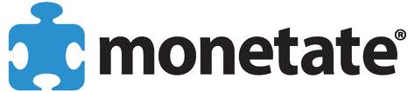






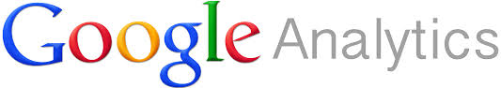
Consumer data landscape
A framework for understanging consumer data
Digital Offline
Recognition
Targeting
Measurement
Name / Address
Demographics
Life Stage Changes
Household
Offline Behaviors
POS & Transactions
Phone
Interest / Lifestyle
Email
Propensities
Industry Channel Data
Viewership
Device
Location
OBA
Conversions
^{MarketShare}
IP
Cookies
Non-industry specific
Industry specific
Not outcome predictable
High outcome predictable
Data vendors specialize in different parts of this “consumer data” landscape

Slide 19
Definition of Data Science
There are many, but most say data science is:
Broad – broader than any one existing discipline
Interdisciplinary: Computer Science, Statistics, Information Science, databases, mathematics
Applied focus on extracting knowledge from data to inform decision making.
Focuses on the skills needed to collect, manage, store, distribute, analyze, visualize, and reuse data.
There are many visual representations of Data Science

Slide 20
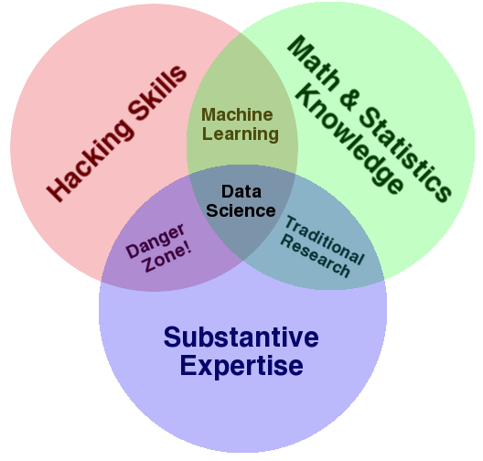
Some definitions link computational, statistical, and substantive expertise.

Slide 21
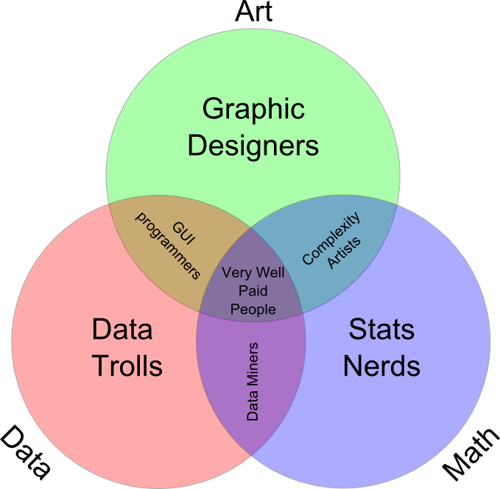
Other definitions focus more on technical skills alone.

Slide 22
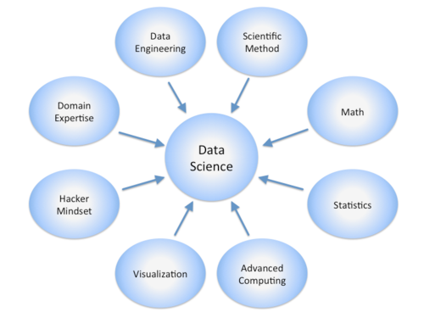
Still other definitions are so broad as to include nearly everything.

Slide 23
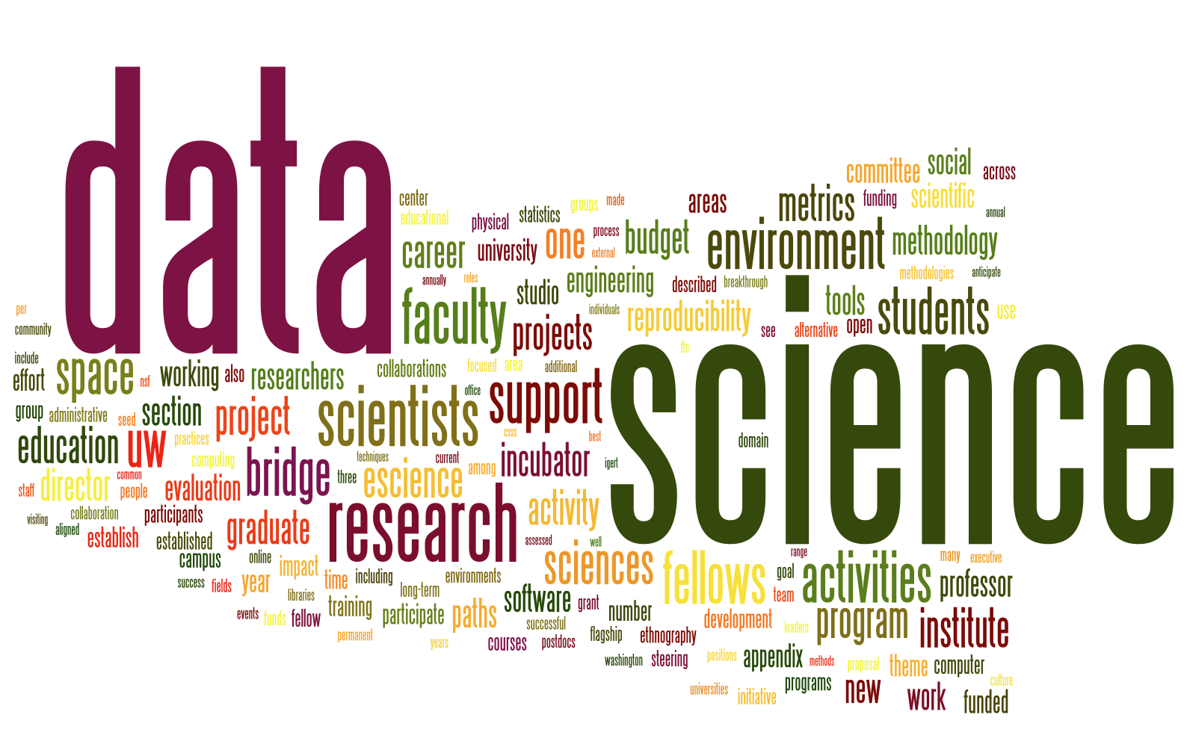
There are many “Word Cloud” representations of Data Science as well.

Slide 24
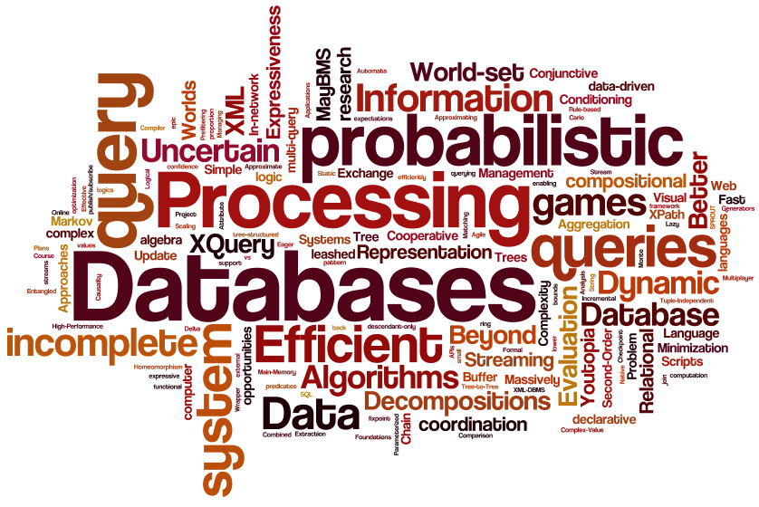

Slide 25
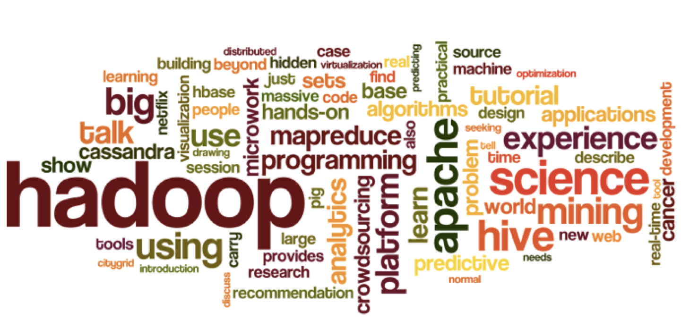

Slide 26
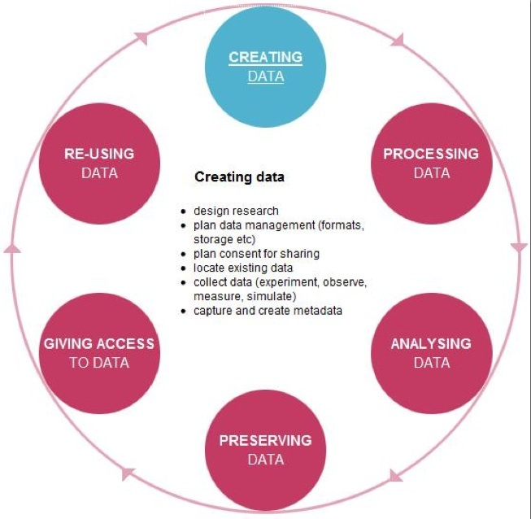

Slide 27
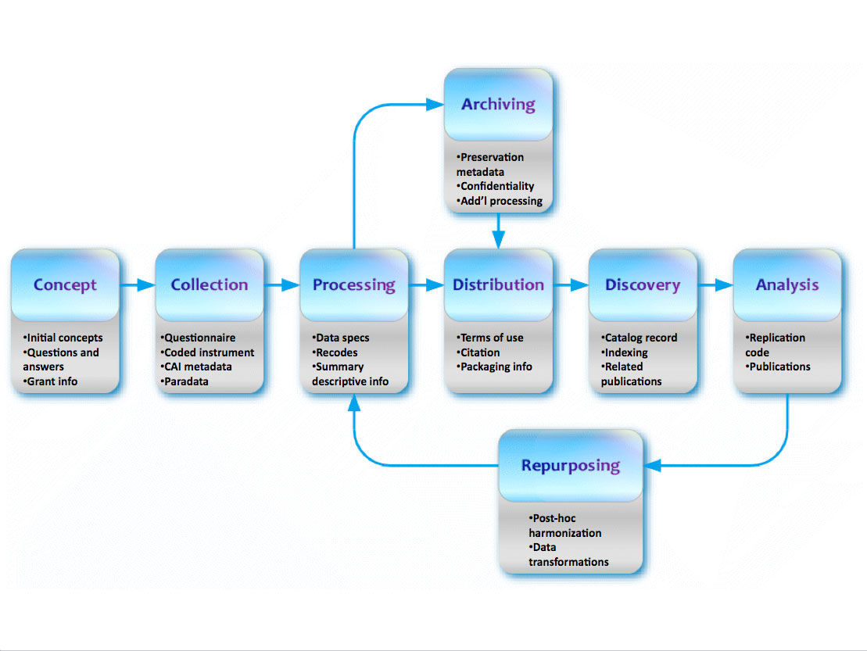

Slide 28
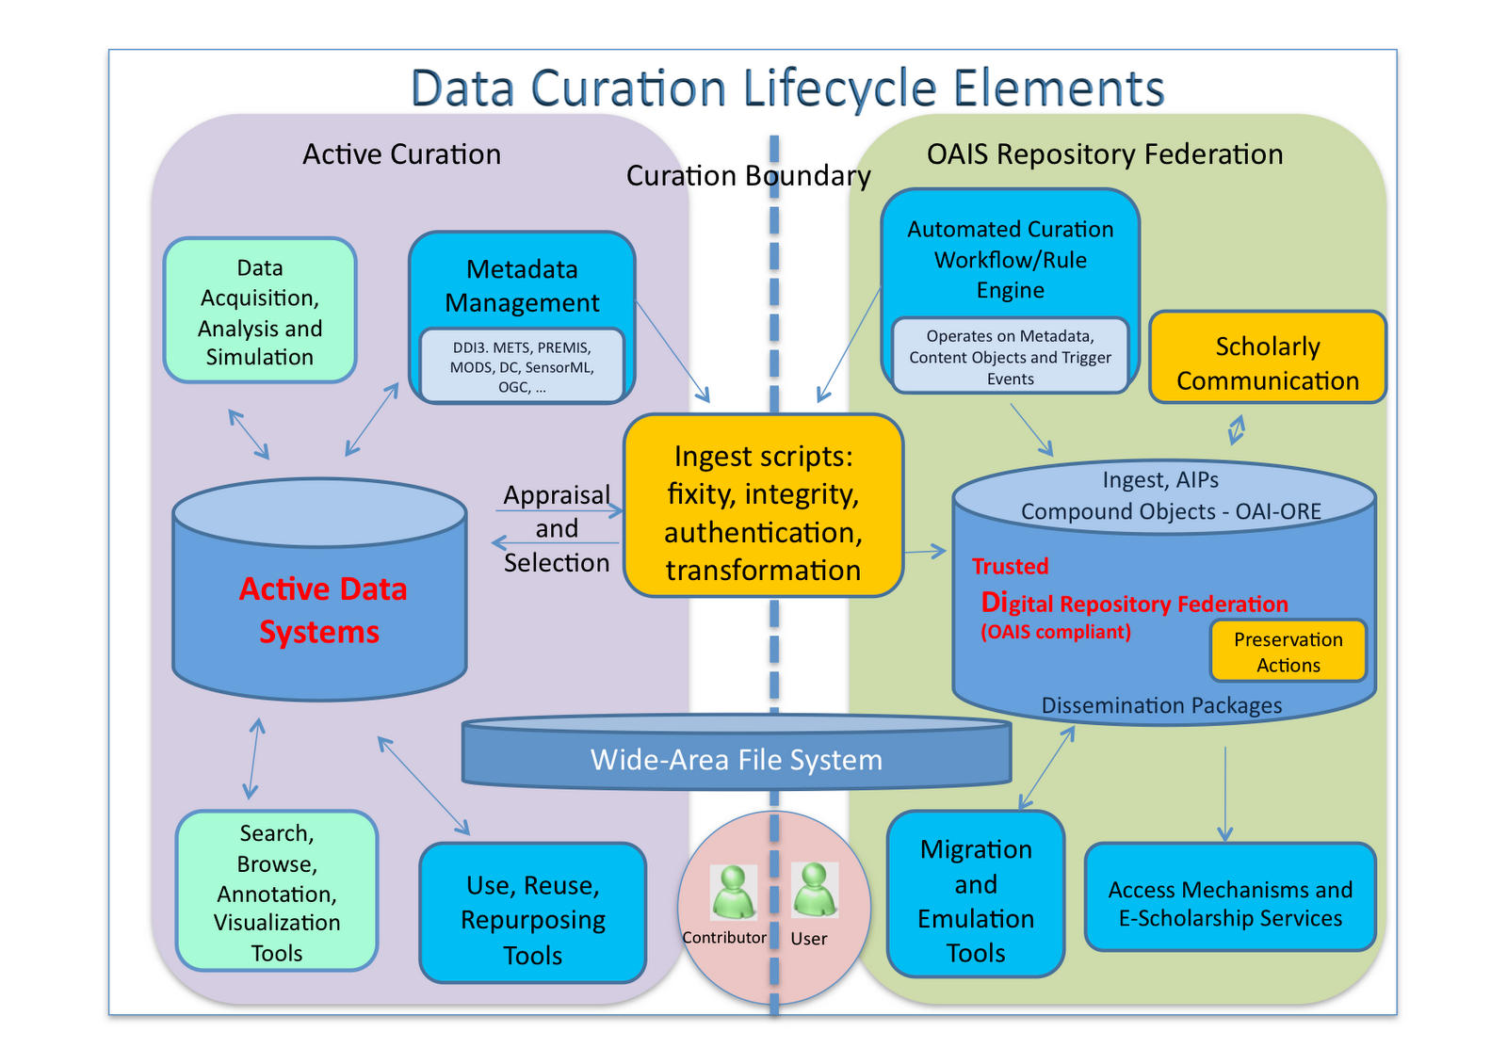

Slide 29
What is Missing?
Most definitions of data science underplay or leave out discussions of:
Substantive theory
Metadata
Privacy and Ethics

Slide 30
Today
Hello
Data Science: what is it?
Course Overview
Python: check-in on codeacademy
Data Ingestion
Jupyter / ipython
Git / VirtualEnv
Check-in

Slide 31
Course github site:
https://github.com/philmui/datascience
git clone https://github.com/philmui/datascience

Slide 32
Getting git
Mac:
brew install git
PC:
https://git-scm.com/downloads

Slide 33
APPENDIX

